Slide 1
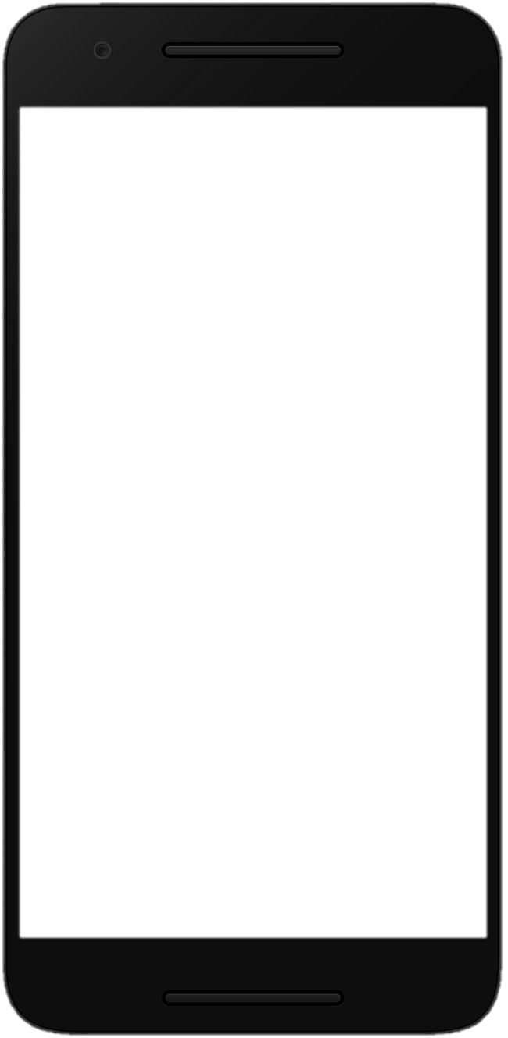
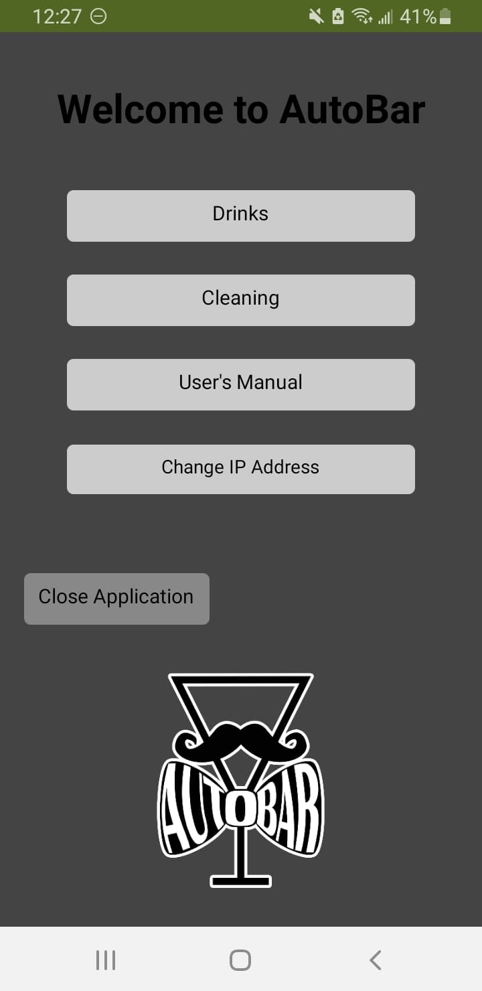
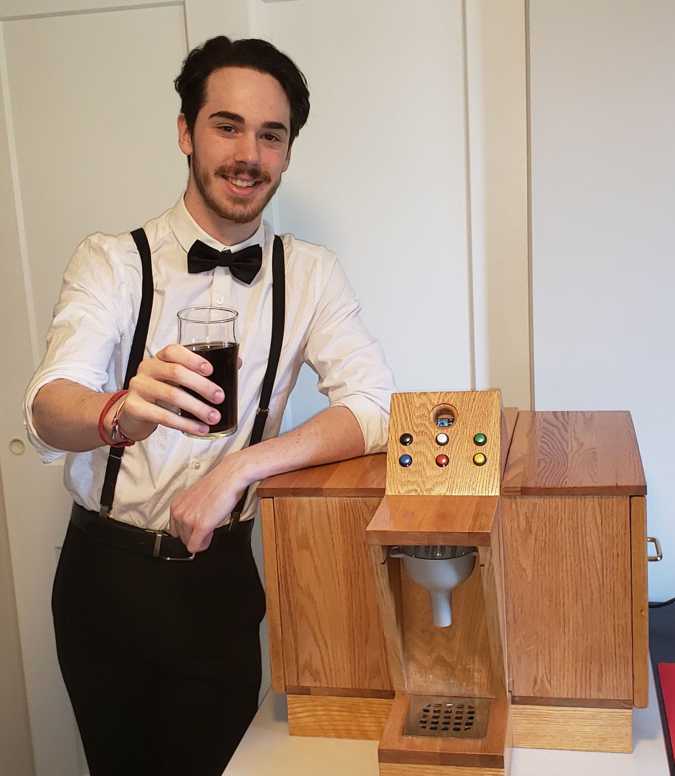
The AutoBar Project
By Alexei Jolicoeur-McCharles
The AutoBar is an automated bartender device that takes drink orders wirelessly via an android application and lets the user dispense their own amount of liquors/mixers via manual buttons. Using air pumps and a 6-relay system connected to an Arduino microcontroller, this device can prepare six different types of drinks in three different sizes. It is also equipped with a cleaning function to clean its tubing.

